Slide 1
Online Examination System
Supervised By: Dr. Amir Hussain
Submitted By:
Muhammad Sami Adil Ali
M. Zain ul Aabedin

Slide 2
Problem Statement:
The current examination processes in educational institutions are often plagued by inefficiencies, security concerns, and logistical challenges.
Traditional methods of conducting exams require significant administrative effort, physical infrastructure, and are prone to human errors in evaluation and result compilation.

Slide 3
Project Overview:
The Online Exam System is a web-based application easily accessible through any browser.
It provides an automated and online examination platform for colleges and universities.
The system can be accessed by school management, faculties, and students.
It features a simple and pleasant user interface utilizing the Bootstrap framework.

Slide 4
Objectives:
To create a reliable and efficient online examination system.
To streamline the examination process for both students and faculties.
To provide a secure and user-friendly platform for managing exams.
To provide an automated and online examination platform for colleges and universities.

Slide 5
Technologies Used
Frontend
HTML
CSS
JavaScript
Bootstrap
Backend
Python
Django
SQLite3

Slide 6

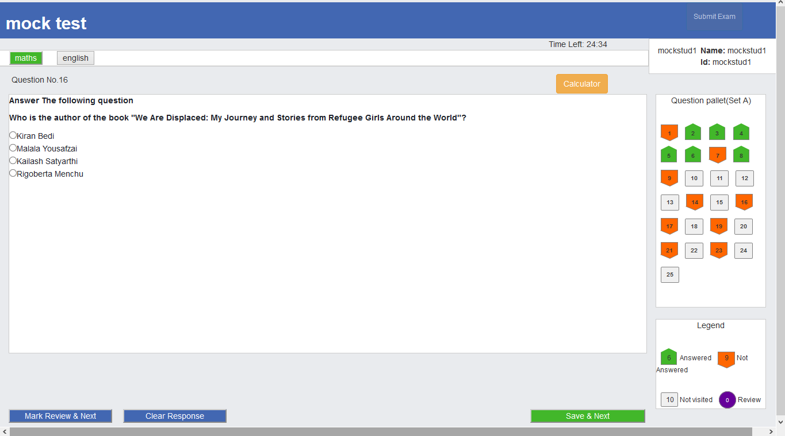
Why Online Examination
Web Based Management System
Web based management System which is reliable
Automation of examination
Flexible assessments
Autograder
Time Saver
Easily create, modify and schedule tests
Can be given at any time

Slide 7
System Overview
Description: The Online Exam System manages online examinations for educational institutions.
Three user roles:
1. Admin: Manages courses, questions, teachers, and students.
2. Faculties: Manages courses and exam questions.
3. Students: Takes exams and views results.

Slide 8

Types of Exams
Entrance Exam
Corporate Exams
Practice Tests
Aptitude Tests
5

Slide 9




Features
Bulk Question upload
Provides large storage that can be extended later
Quick & detailed reports
Auto grading with real time student performance.
Administrative control
Full control over exam
Data Security
Encoded data storage which prevent data leak

Slide 10
Admin:
Admin will create test
Admin will login into system
Admin will add candidate data
Admin will upload question bank with sets
Admin will set time of the exam
Admin will set marks for the exam
Admin will set negative marks for the wrong response

Slide 11
Teacher:
Teacher will add course, questions and specify correct answers

Slide 12
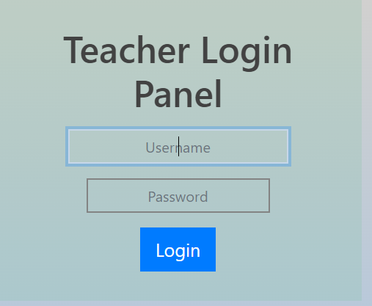
1.
Securly login with Examiner credentials
Logo
10

Slide 13
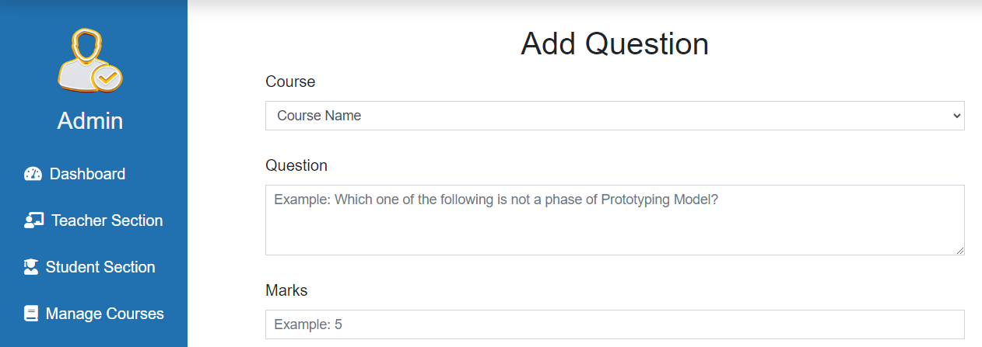
2.
Set exam and other data and Upload Questions
11

Slide 14
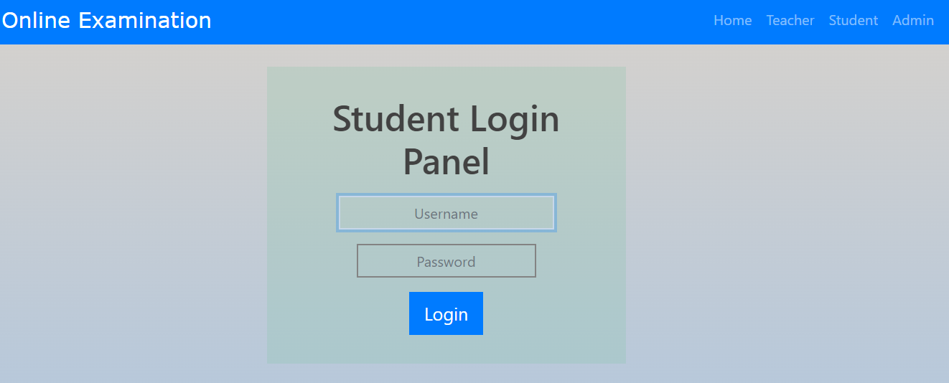
3.
Allow student Login
12

Slide 15
5.
Exam will finish once time is over. All the results can be view from main server with secure credentials.
14

Slide 16
Candidate:
Candidate will login, attempt questions and finish the exam

Slide 17
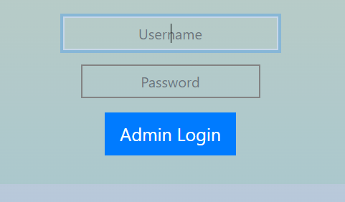
1.
Securly login with credentials
Logo
16

Slide 18
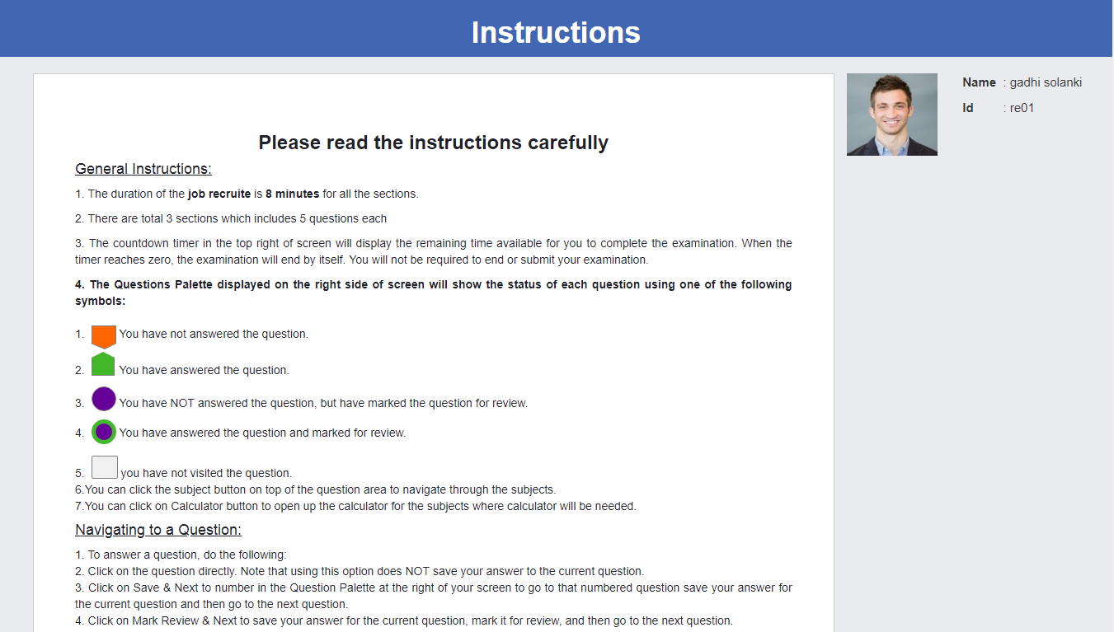
2.
Read and accept the instructions
17

Slide 19
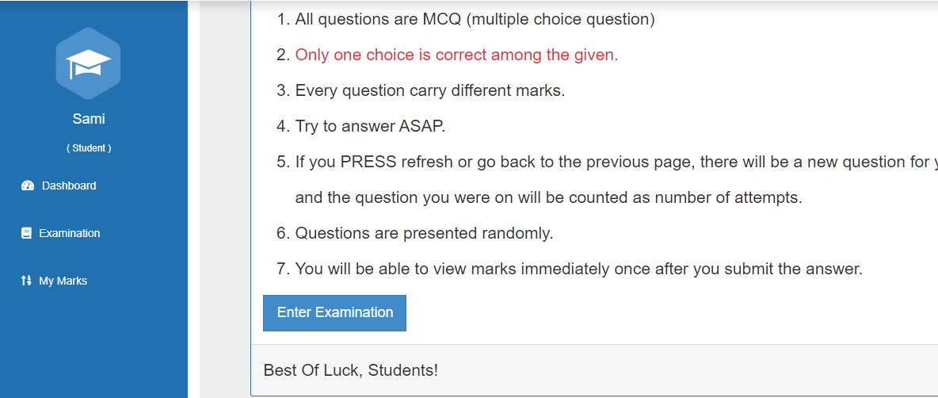
2.
Start attempting questions
18

Slide 20
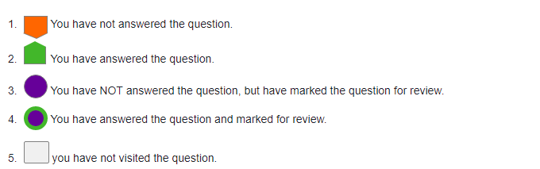
2.
Question pallet will change buttons according to candidate response

Slide 21
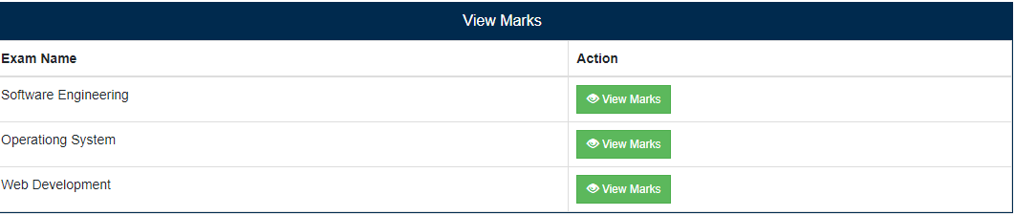
3.
Candidate can finish the exam and check the score
20

Slide 22
3.
Result & Reports. Acceron System allows you to print, download and share beautiful PDF for your reports. You can print certificates, reports, lists, scorecards and even question papers quickly. Our printer friendly format gives you the best possible savings on printer paper and ink. You can also send PDF reports directly to your candidates on a single click.
21

Slide 23
3.
Export your data Create and preserve your data Export your data such as Questions, candidates, groups and sections in a popular file format such as Microsoft Excel. This data can also be shared with anyone you want easily. Hence, sharing and preserving of your valuable data are made possible with minimum efforts. You can again import the same data into our system with ease by a single click. Also, you can use these files in other LMS systems for quiz and assessment purposes.
22

Slide 24
Other\Functionalities
Candidate cannot finish the exam prior 15 minutes of end time
Exam will end when candidate click the option finish
Candidate cannot use keyboard
Using keyboard or attempting to cheat will lock the user and he cannot log back in without administrator permission
Candidate cannot start the exam before time

Slide 25
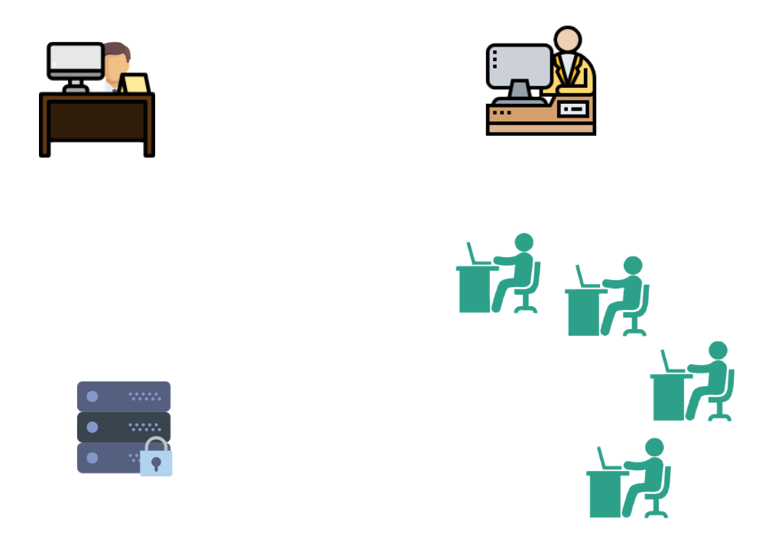

How It Works
Developer/ System Administrator
Examiner
Candidates
Server

Slide 26
Hardware Requirement:
Processor: Pentium Silver
Ram: 8GB
SSD: 256GB

Slide 27

Thank You

